Slide 1
listen …

Slide 2
listen …

Slide 3
GES1011/GESS1009
The Evolution of a
Global City-State

Slide 4
Final Test: Questions will be emailed to you and also available on Luminus.
Take Home Open Book Test (20%)
Date: 11 November 2022
Time of Release: 6:00 p.m.
Time Allowed: 24 hrs
Submission: into designated LumiNUS Workbin .
I will be available via Zoom for the first 30 minutes should you have any questions

Slide 5
recap …
after the war ...
decolonization (an ongoing process) ...

Slide 6
recap ++ …
borders of modern nation-states drawn by colonial powers ...
in the region, Anglo-Dutch Agreement 1824 ...

Slide 7
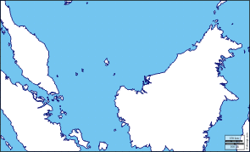
recap ++ …

Slide 8
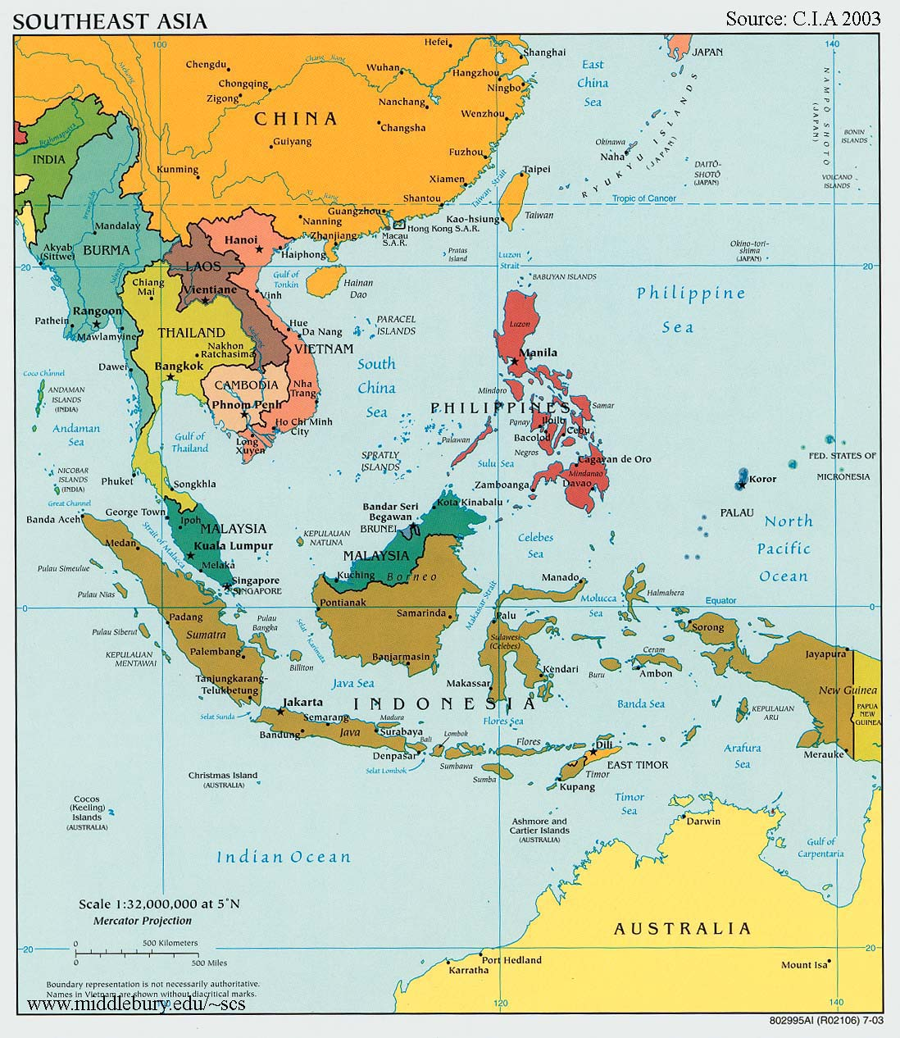
recap ++ …

Slide 9
recap ++ …
as decolonization takes place, and national borders are regulated ...
freedom of movement across the globe (especially across nation-states) virtually ends ...

Slide 10
recap ++ …
nations lump together different people groups: different languages, religions, classes ...
confining them within borders ...
leaving leaders of decolonizing contexts to build nations out of disparate groups of people ...

Slide 11
our task today …
decolonization (demographic and cultural ) ...
music and society ...
soundscapes of Singapore ...
decolonisation and globalisation ...

Slide 12
our task today …
shifting gears …
for last two lectures …
not really history …
too ‘recent’ for robust historical inquiry …
but issues of wider general concern …
last third of this lecture will be centered on four songs …

Slide 13
Question and Response

Slide 14
decolonizing Singapore ...
population growth in Singapore 1960 to 1990 …
1960 (1.40m)
1970 (2.10m)
1980 (2.40m)
1990 (3.04m)

Slide 15
decolonizing Singapore ...
1970 (2.1m)
Chinese 77%, Malay 14.8%, Indian 7.0%, Others 1.0% ...
Citizen 97%, Non-Citizen 3%

Slide 16
decolonizing Singapore ...
1990 (3.0m)
Chinese 77.8, Malay 14.0, Indian 7.1, Others 1.1
Citizen 89.8 Non-Citizen 10.2*

Slide 17
decolonizing Singapore ...
in the Singaporean context ...
some of the differences within society (race and religion) have led to violent conflicts in the past ...
and national leaders had to bear in mind and seek to counter and overcome such sources of conflicts ...
security legislation, close surveillance, multiculturalism, religious tolerance ...
national songs that exhort political and communal stability, and promise economic progress ...

Slide 18
decolonizing Singapore ...
2010/1 (5.2m)
Chinese 74.1, Malay 13.4, Indian 9.2, Others 3.3
Buddhist 33.3
Taoist/(folk beliefs ’connected’ to Taoism) 10.9
Islam 14.7
Christian 18.3
Hindu 5.1
Non-Affiliated 17.0
Citizen 73% Non-Citizen 27%

Slide 19
decolonizing Singapore ...
as far the project of nation building was concerned ...
the government had to pivot and re-pivot within relatively short periods of time ...
to grapple with significant demographic shifts ...
many sites to analyse or track these adjustments ...
national songs can be one of them ...

Slide 20
Question and Response

Slide 21
music and society ...
music has been a prominent means of identity construction ...
first instance ???
The Reformation ...

Slide 22

music and society ...

Slide 23
music and society ...
more prominent political tune ???
???
Le Marsellaise ...
Liberty, Equality, Fraternity ...
for the bourgeoisie …
(moneyed and propertied upper middle class)

Slide 24
music and society ...
6 September 1958, reopening of the Victoria Memorial Hall …
search for a song to commemorate the official reopening …
a composer is identified …
a song is composed …
Majulah Singapura (Onward Singapore)
is born and performed for the first time …

Slide 25
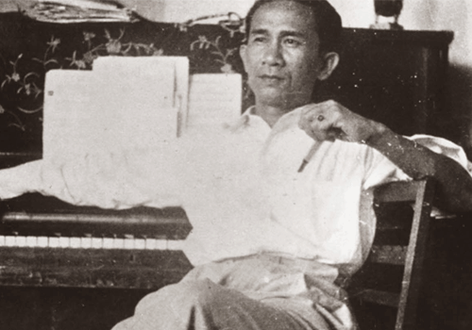
music and society ...

Slide 26
music and society ...
Zubir Said (22 July 1907 -16 November 1987) …
one of a sizeable number of pre-war migrants from Sumatra in the 1920s (1928) …
of Minangkabau descent …
in consultation with a few others …
composes Majulah Singapura …

Slide 27
music and society ...
Mari kita ra'yat Singapura, Bangun dengan bersatu sama-sama. Rukon damai dan bantu membantu, supaya kita sama-sama maju.
Kita hidop aman dan sentosa, Kerja sama menuju bahagia! Chita-chita kita yang mulia: Berjaya Singapura!
Mari-lah kita bersatu, Dengan semangat yang bahru. Samua kita berseru: MAJULAH SINGAPURA! MAJULAH SINGAPURA!
Come, fellow Singaporeans Rise and Unite Together
Law Abiding and Helping One Another So that We Progress Together
We live in Peace and Tranquillity Working together towards Happiness May our noble aspirations
Bring Singapore success
Come, let us unite In a new spirit Together we proclaim Onward Singapore Onward Singapore

Slide 28
music and society ...
lyrics in Malay …
Malay most widely spoken language across all migrant communities (races) …
1957 census …
Hokkien and Malay most spoken languages …
how many spoke English?
1.8%

Slide 29
music and society ...
Mandarin as ‘mother’ tongue ?
0.1%
how many spoke Malay?
48%

Slide 30
music and society ...
speaks of a people uniting and helping one another …
notice the use of ‘sama’ and ‘sama-sama’ …connoting togetherness …
also the invocation to help each other (bantu-membantu)
to progress together …
towards happiness …
thereby bring Singapore (still a colony) success …

Slide 31
a story of a song …
Mari kita ra'yat Singapura, Bangun dengan bersatu sama-sama. Rukon damai dan bantu membantu, supaya kita sama-sama maju.
Kita hidop aman dan sentosa, Kerja sama menuju bahagia! Chita-chita kita yang mulia: Berjaya Singapura!
Mari-lah kita bersatu, Dengan semangat yang bahru. Samua kita berseru: MAJULAH SINGAPURA! MAJULAH SINGAPURA!
Come, fellow Singaporeans Rise and Unite Together
Law Abiding and Helping One Another So that We Progress Together
We live in Peace and Tranquillity Working together towards Happiness May our noble aspirations
Bring Singapore success
Come, let us unite In a new spirit Together we proclaim Onward Singapore Onward Singapore

Slide 32
music and society ...
Singapore, with a fully elected Legislative Assembly in June 1959 …
new (PAP) government is looking for nationalistically themed symbols (anthem, flag and crest)…
one of which was a song/anthem ...
decision was to use a slightly altered form of Majulah Singapura …
made official on 11 November 1959 …

Slide 33
music and society (alterations) ...
Mari kita ra'yat Singapura, Bangun dengan bersatu sama-sama. Rukon damai dan bantu membantu, supaya kita sama-sama maju.
Kita hidop aman dan sentosa, Kerja sama menuju bahagia! Chita-chita kita yang mulia: Berjaya Singapura!
Mari-lah kita bersatu, Dengan semangat yang bahru. Samua kita berseru: MAJULAH SINGAPURA! MAJULAH SINGAPURA!
Mari kita rakyat Singapura Sama-sama menuju bahagia Cita-cita kita yang mulia Berjaya Singapura
Marilah kita bersatu Dengan semangat yang baru Semua kita berseru Majulah Singapura Majulah Singapura
Mari-lah kita bersatu, Dengan semangat yang bahru. Samua kita berseru: MAJULAH SINGAPURA! MAJULAH SINGAPURA!

Slide 34
music and society (alterations) ...
Come, fellow Singaporeans Rise and Unite Together
Law Abiding and Helping One Another So that We Progress Together
We live in Peace and Tranquility Working together towards Happiness May our noble aspirations
Bring Singapore success
Come, let us unite In a new spirit Together we proclaim Onward Singapore Onward Singapore
Come, fellow Singaporeans Let us progress towards happiness together May our noble aspiration bring Singapore success
Come, let us unite In a new spirit Together we proclaim Onward Singapore Onward Singapore
Come, let us unite In a new spirit Together we proclaim Onward Singapore Onward Singapore

Slide 35
music and society ...
lyrics in Malay …
speaks of a polity progressing towards happiness together …
and thereby bring Singapore success …

Slide 36
music and society ...
musically 8 bars have been taken out …
any thoughts?
lyrically, intra-citizen connections beyond the pronoun ‘we’(‘kita’) have largely been dropped …
one ‘sama-sama’ remains …
making song more state centric (allegiance to state)…
as opposed to being people and state referencing …
agree???

Slide 37
music and society ...
there are differences …
are the differences significant?
a politically unconnected first generation migrant …
lyrically and musically articulating his aspirations for members of his still colonised society …

Slide 38
music and society ...
first composes it in 1958 …
alters it in 1959 (on govt’s request) …
how many people noticed?
I don’t think many …

Slide 39
music and society ...
but given what you know of Singapore’s impressive development and success that followed …
the altered version seems somewhat prescient/prophetic …
statist success, with the people or citizenry in the background …
we become what we sing ???
to be sure, the people do or can benefit as an effect of the flourishing of the state …

Slide 40
Question and Response

Slide 41
draft papers …

Slide 42
soundscapes ...
national music implies music in which a nation’s emotions and passions are expressed ...
exhibiting characteristic peculiarities ...
that distinguishes it from every other nation ...

Slide 43
soundscapes ...
Singapore’s national songs express the idea of how multiple communities constitute the nation ...
hoping to foster a national identity ...
populist strategy that caters not only to high-brow groups ...
pop songs, use of the guitar, etc. ...
after 1998, sung by prominent local musicians ...

Slide 44
soundscapes ...
to convince Singaporeans to develop a love for the nation, a sense of patriotism and a “willingness to support the ruling elite (Kong)”...
to build an imagined community: Anderson
a nation is a socially constructed community, a grouping imagined by people who may not have face-to-face communication or contact with one another but who perceive themselves as part of that larger group …

Slide 45
soundscapes ...
in SG, a policy of integration; not assimilation ...
ethnic and cultural identity to be nurtured alongside a larger/prior commitment to nation ...
multiplicity of identities ...

Slide 46
soundscapes ...
a field of interaction of sound events (songs) ...
which offer opportunities for the negotiation of meaning ...
through acts of listening and analyzing its component sound events ...

Slide 47
soundscapes ...
understanding these practices allow one to gain an understanding of behavioural patterns of people who create, perform and attend to them ...
[music as a site of social (knowledge) construction]

Slide 48
listen …

Slide 49
listen …

Slide 50
listen …

Slide 51
listen …

Slide 52
Question and Response

Slide 53
decolonisation and globalisation …
borders ...
porous borders (economically) ...
if globalisation takes root ...
it may mark a significant compromise or even the end of the nation-state ...

Slide 54
decolonisation and globalisation …
for SG and its counterparts ... a roughly half century experiment/experience ends ...
for some European polities ...
one and a half centuries ...

Slide 55
decolonisation and globalisation …
reconnect with the last 1-200,000 years of freedom of movement ...
in the words of Simon and Garfunkel ...

Slide 56
decolonisation and globalisation …
I am a citizen of the planet I was born here I'm going to die here Come what may I am entitled by my birth to the treasures of the earth no one must be denied these no one must be denied

Slide 57
decolonisation and globalisation …
the nation-state and decolonisation overcome by the dominant tendency of most of our pasts ...

Slide 58
Question and Response

Slide 59
Final Test: Questions will be emailed to you and also available on Luminus.
Take Home Open Book Test (20%)
Date: 11 November 2022
Time of Release: 6:00 p.m.
Time Allowed: 24 hrs
Submission: into designated LumiNUS Workbin .
I will be available via Zoom for the first 30 minutes should you have any questions

Slide 60
the humanities …
“My humanity is bound up in yours,
for we can only be human together.”
Archbishop Desmond Tutu

Slide 61
Question and Response

